Slide 1
Supercontinents

Slide 2

By the end of this lesson you should be able to:
Define the term supercontinent.
List three of Earth's most recent supercontinents.
Describe the key characteristics of each supercontinent.
Evaluate the evidence geologists have for the presence of supercontinents and the extinct lifeforms that lived on them.

Slide 3
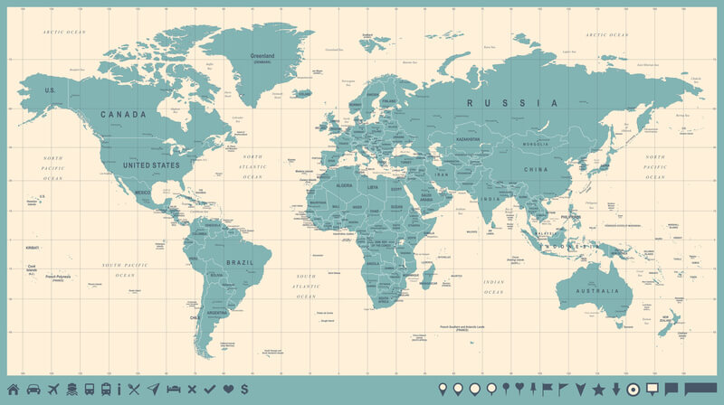
Take a quick look at the world map below. What do you see?
All world maps show countless countries, arranged into seven large continents that are separated by vast oceans.
Even if a world map is an up-to-date version like this one, or a slightly crunchy, odd-smelling, old bit of paper that's been dragged out of a drawer somewhere, chances are all of the countries and continents will look roughly the same.
What's interesting about that? Well, Earth's landmasses haven't always been arranged this way—millions and billions of years ago, the Earth looked very different. In this lesson, we will do a little bit of time travelling to find out how!

Slide 4
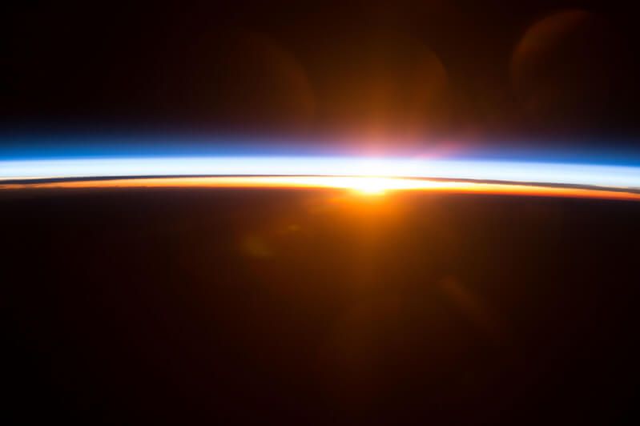
Today, there are seven key continents that make up the Earth.
These are Europe, Asia, Africa, North America, South America, Australia and Antarctica. Often, we think of these land masses as being vast, unmoving structures that have looked the same for an age. However, Earth hasn't always looked like it does now and the continents we know and live on today didn't always exist!
Millions and billions of years ago, these continents were pushed and pulled together in many ways, forming entirely different land masses. We call these ancient landmasses supercontinents.

Slide 5
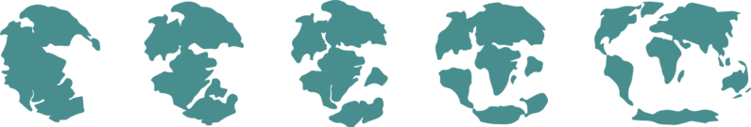
What puts the "super" in supercontinent?
Supercontinents are ancient, giant landmasses. It's thought that at different times in Earth's history, almost of all of the world's land was combined into supercontinents.
Imagine continents such as North America, Europe and Asia, which are already very large, combined to form a single, huge land mass! The three main supercontinents we will cover in this lesson are called Pangaea, Laurasia and Gondwana.

Slide 6
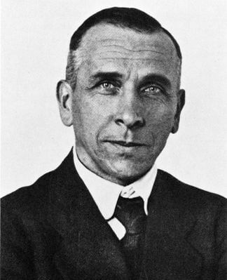
Before we learn all about Earth's past supercontinents, we need to recap exactly how these landmasses have moved about in the first place.
This is where Alfred Wegener comes in! In 1912, he proposed a theory that the Earth's continents shift over time and were once all joined together in a giant landmass. He called this landmass Pangaea and his theory continental drift.
Wegener's theory of continental drift initially came from studying the shapes of our continents, which appear to fit together in certain places.

Slide 7
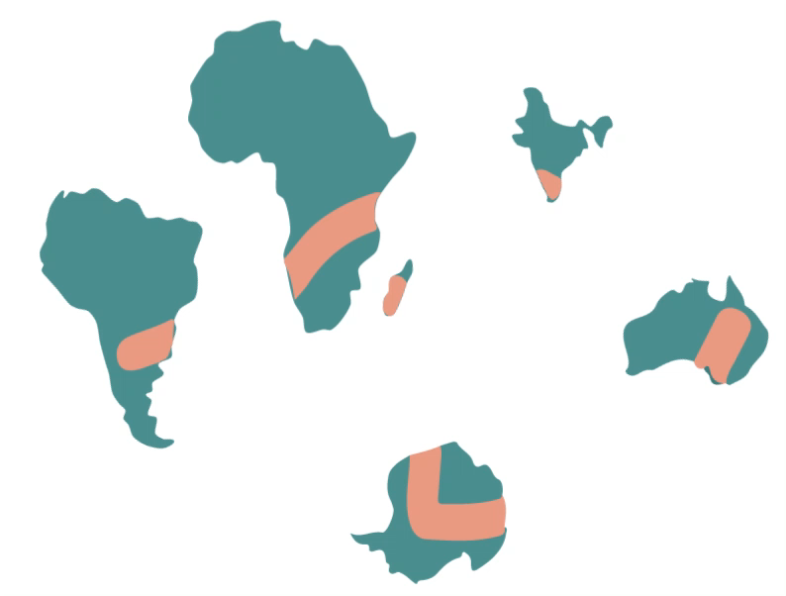
Wegener had to work hard to show that continental drift explained how the continents have moved over time.
One of the key pieces of evidence for his theory came from fossils. Wegener had found that fossils of the same species had been found on different continents.
Why was this so revolutionary? Well, let's look at an example! The plant Glossopteris was a large tree that emerged almost 300 million years ago. Its fossils are found in South America, India, South Africa, Australia and Antarctica, but its seeds were too heavy to drift on ocean currents to reach all these different places.
Therefore, this is evidence that at least all these continents must have been joined together at some stage, as shown in the video below.

Slide 8
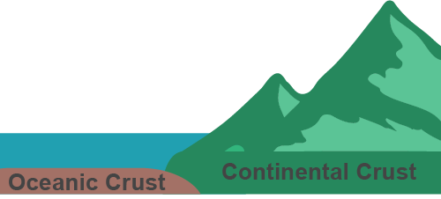
Now that we know Earth's continents can move, let's look at exactly how they do that.
Earth's lithosphere (the crust and top part of the mantle) is broken up into large rocky sections called tectonic plates. These plates are made of either continental crust or oceanic crust.
Continental crust is the thicker part of the crust that makes up all the land on Earth. Essentially, continental crust is what results in continents! In contrast, oceanic crust is thinner and found under oceans and seas.

Slide 9
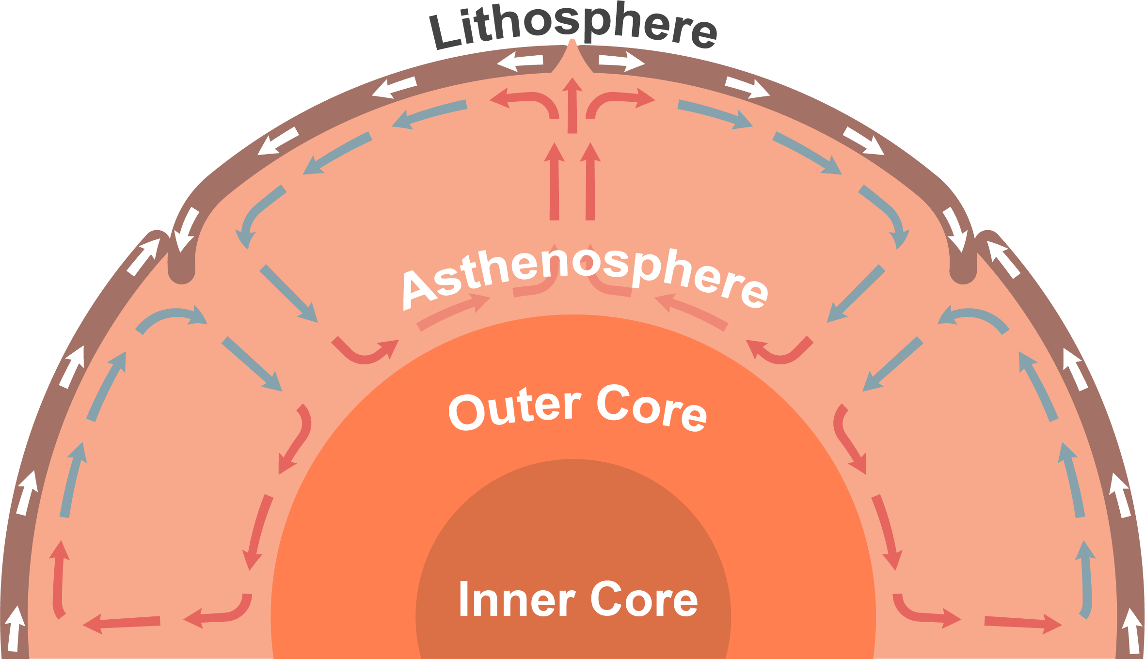
Underneath the lithosphere is the asthenosphere, another part of Earth's mantle.
The asthenosphere is made of rocks that are so hot they have become soft. These rocks are so soft they can move through a process called convection, but only very slowly.
As the asthenosphere slowly moves the lithosphere's tectonic plates move along with it—pushing continental crust and therefore, the continents, together or pulling them apart.

Slide 10
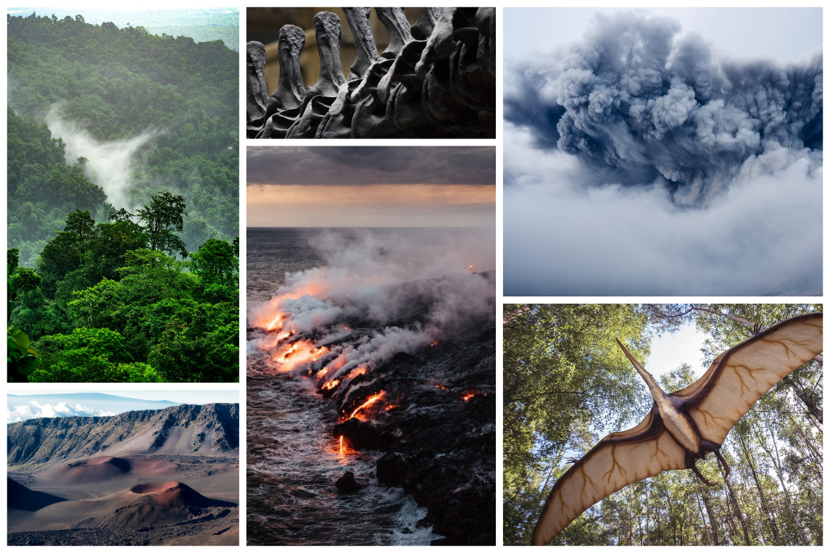
Continental drift and plate tectonics show us that the continents can move, changing the face of the Earth.
This movement of the plates and Wegener's fossil evidence demonstrates that at one stage in geological time, Earth really was home to a supercontinent made up of almost all its landmasses.
Not only did this supercontinent make the Earth look very different, it was also subject to very different climate and weather conditions compared to what we experience today. There was wild volcanic activity, and this supercontinent was also home to all sorts of unique plants and animals that today, we can only see online or in museums.
It's fair to say that Earth has seen a lot change over its estimated 4.5 billion years! In the next section, we are going to start 335 million years ago at Alfred Wegener's supercontinent Pangaea.

Slide 11
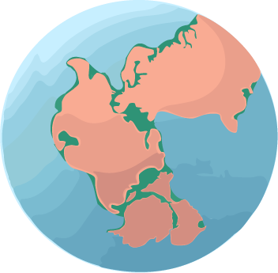
Around 335 million years ago, almost all of Earth's land was joined together to form the supercontinent Pangaea.
Pangaea had formed very gradually over several hundred million years, as the tectonic plates carrying scattered pieces of land moved together slowly over time. Once formed, Pangaea remained relatively unchanged for the next 100 million years.
However, the life forms on Pangaea are a different story! The formation of Pangaea resulted in the largest mass extinction of life in history, with approximately 90% of plants, 95% of marine species and 70% of animals dying out. However, this extinction also paved the way for the evolution of entirely new life forms.

Slide 12
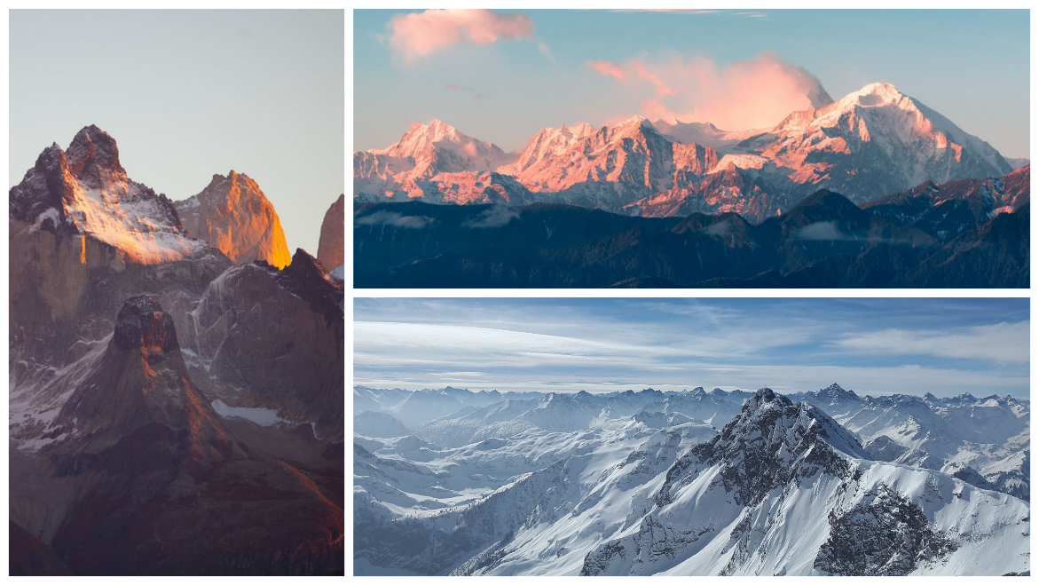
The slow movement of continents to form one big landmass doesn't sound too dramatic, so why did almost 80–90% of species disappear once Pangaea formed?
This has been a bit of a puzzle for geologists, but they are slowly managing to put the pieces together to understand this mass extinction event. To understand it ourselves, we need to look at what the landscape of Pangaea was like.
First, as the tectonic plates collided, forming Pangaea, the continental crust on top of the plates folded. These collisions resulted in the formation of massive mountain chains throughout Pangaea.

Slide 13
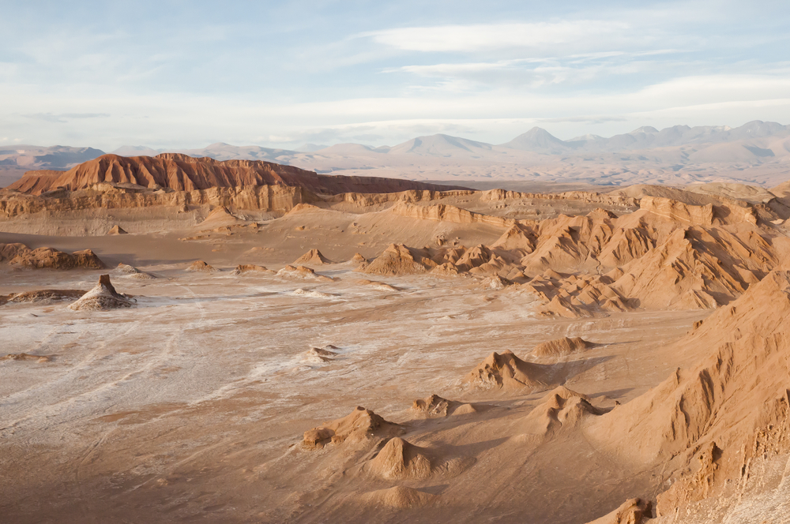
Mountains have a huge effect on climate, as they are very effective at blocking rainfall.
These mountains around Pangaea meant that its inside became dry. Very dry. This also meant that Pangaea's interior experienced wild temperature changes from season to season, in comparison to the land on the water's edge.
Speaking of water, the formation of Pangaea also affected the ocean, as well as the species that lived in it.
Having one big landmass instead of lots of little ones meant that the ocean was very deep, much deeper than our oceans today!

Slide 14
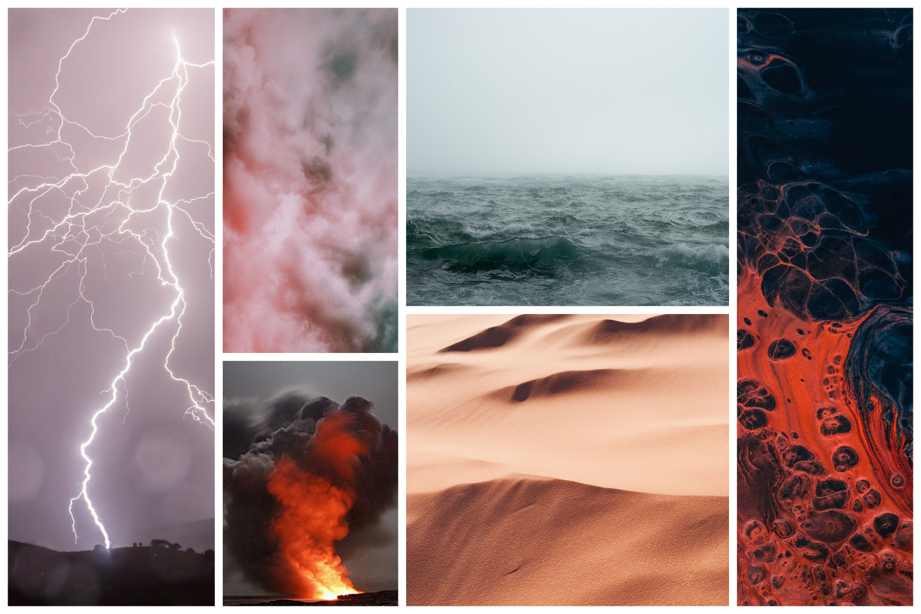
So what do we have so far? An enormous chunk of land with barely any rain, extreme temperature changes and surrounded by a single, deep ocean.
The formation of this supercontinent also resulted in sea-level changes, changes in the depth and oxygen levels of the ocean, as well as global temperature changes and volcanic activity brought on by the shifting of tectonic plates.
These factors, as well as many others that geologists are still studying, caused approximately 80–90% of all species in the land and sea to go extinct over a period of about 8 million years. These species simply couldn't adapt to the conditions on and around Pangaea!

Slide 15
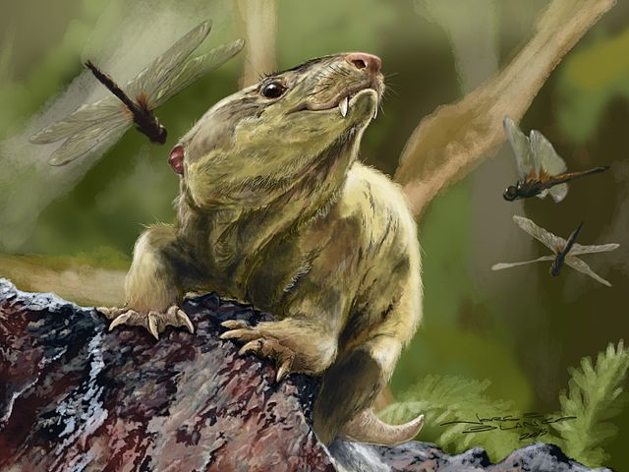
Pangaea wasn't all doom and gloom, as new life rapidly evolved after this mass extinction event.
Bacteria, fungi, plants, insects, reptiles, early mammals and the first birds all thrived in the conditions on Pangaea. Nipping around between giant insects, towering trees and flowering plants were a particularly interesting group of herbivores.
Looking like a cross between a very large dog and a reptile, with huge, strong heads and charmingly stubby tails, these were the Traversodonts. Traversodonts were a family of cynodonts—the ancestors of modern mammals.

Slide 16
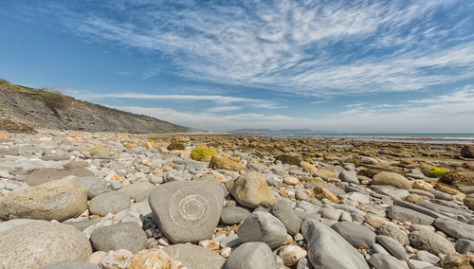
However, we aren't just here for early mammals. What about the dinosaurs?
Famously, Pangaea was home to many early species of dinosaurs, which began to evolve around 230 million years ago.
These species included large, primitive dinosaurs that we actually know very little about! Pangaea was filled with life, most of which looked very different to the plants and animals we see out our windows today.

Slide 17
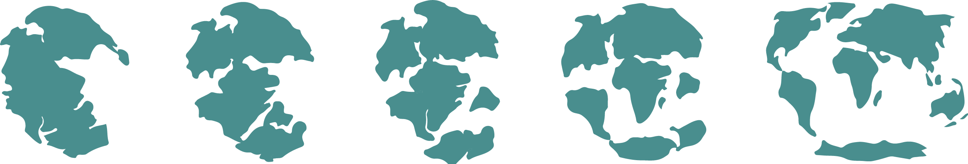
So far, we have covered the continents that made up Pangaea, its climate and its different life forms. That's all wonderful, but how do we know this?
After all, Pangaea hasn't existed for 175 million years! Well, scientists like Wegener could first work out the shape of Pangaea by looking at the shapes of modern coastlines.
This allowed them to piece together the landmasses that made up Pangaea, and also gave them an idea of what it might have looked like. Other information about Pangaea comes from all-important fossil evidence.

Slide 18
We have plenty of fossils of species that lived in Pangaea, which is how we know so much about the plants and animals of the time.
These fossils also gave geologists an idea about the shape of Pangaea. As mentioned earlier, the locations of fossils from Pangaea were found all over the world, on many different present-day continents. However, these fossils were of plants and animals that wouldn't have been able to cross the vast oceans between continents.
It was only until geologists tried moving the continents around that these fossil locations made sense, and geologists could get an idea of how large Pangaea really was! Watch the video below to show how the distribution of fossils across different continents provided evidence for the shape of Pangaea's southern half.
Fossils of animals that lived in shallow water also allowed geologists to work out where Pangaea's coastline was.

Slide 19
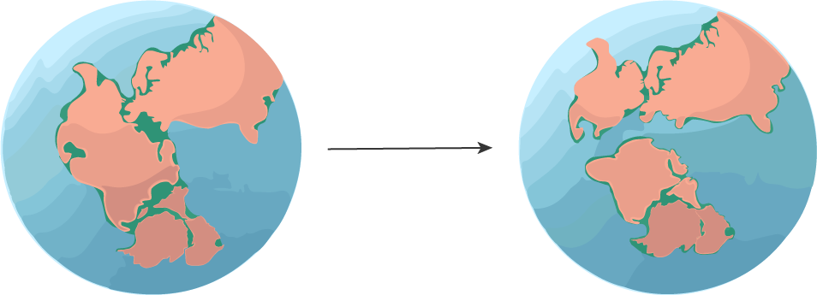
Once the shape of Pangaea was determined, geologists could use this information to infer what the climate and weather conditions would have been like.
Problems solved! However, Pangaea didn't just stay the same for the next few hundreds of millions of years. Instead, it started coming to a somewhat gradual end around 200 million years ago.
That's not to say that Pangaea's end wasn't without drama! From 200–100 million years ago, the tectonic plates that formed Pangaea began to pull away. This plate movement likely contributed to earthquakes, tsunamis, the formation of large rifts in the landscape and increased volcanic activity. However, all of this drama unfolded very slowly!
Eventually, Pangaea split into two smaller supercontinents: Laurasia and Gondwana.

Slide 20
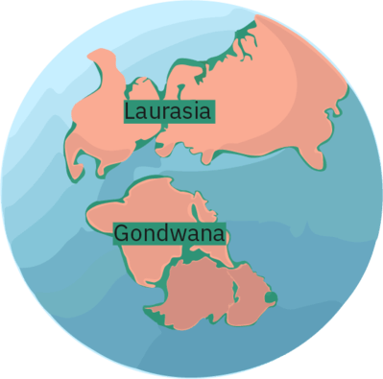
175 million years ago, Pangaea eventually finished breaking up, forming two smaller supercontinents called Laurasia and Gondwana.
These two landmasses are thought of as supercontinents in their own right, as they were both much bigger than any continent existing today!
The northern half of Pangaea became known as Laurasia. This particular supercontinent was made up of the landmasses we now call North America, Europe and Asia.
After it separated from the rest of Pangaea, Laurasia developed its own unique life forms, including some of the world's most famous dinosaurs!

Slide 21
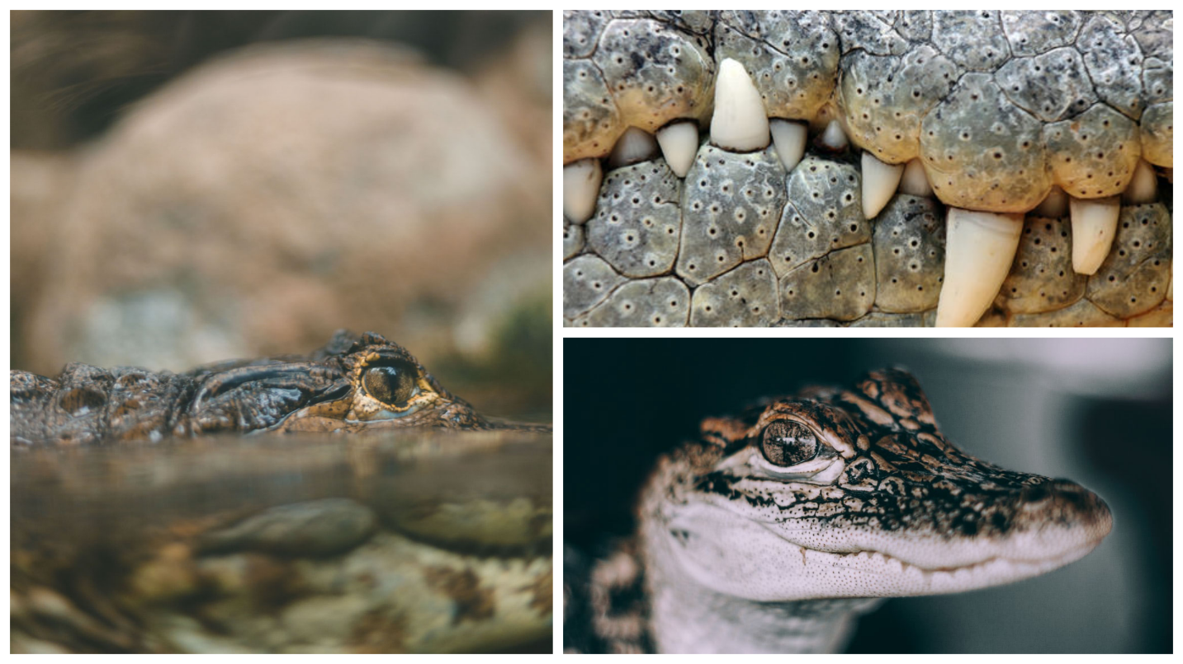
The climate in Laurasia was much less extreme than Pangaea.
Humidity increased around Laurasia's coastlines, and the changing of the seasons was also less extreme.
Shallow coastlines returned, as did diverse marine life. Giant crocodiles and sharks cruised in the shallows, weaving between coral reefs and hunting fish-like creatures similar to what we see in our oceans today.

Slide 22
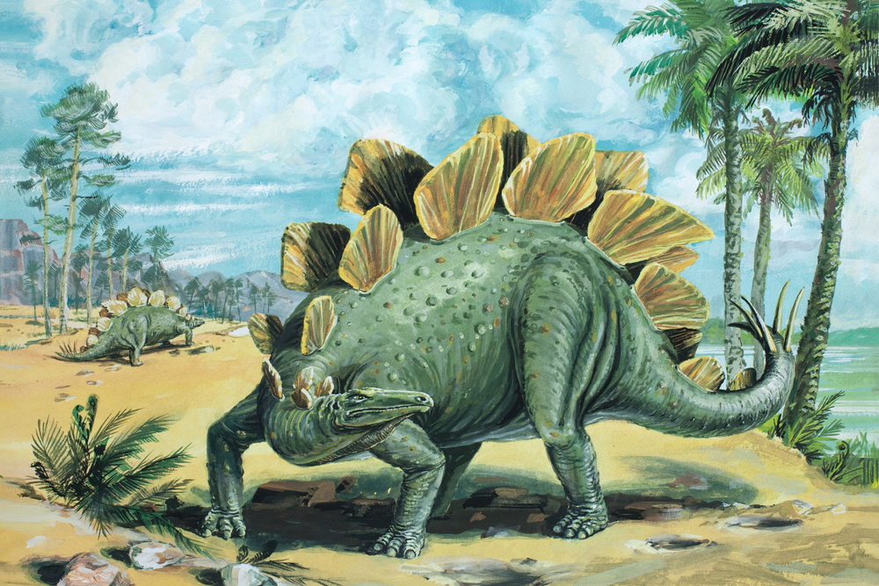
Laurasia's land had a warm, sub-tropical climate that was perfect for lush forests to flourish.
A sub-tropical environment is characterised by hot and humid summers, and reasonably mild winters. Plants adapted to these conditions over time, and the forests that formed came to support thriving populations of dinosaurs! Plodding along the landscape were huge long-necked plant-eating dinosaurs like the Diplodocus, and racing along beside them were fearsome carnivorous species like the Allosaurus, looking for their next meal.
Stegosaurus, a plant-eating dinosaur the size of a bus with huge plate-like spines also thudded across the landscape looking for food—likely causing smaller creatures to hurry out of their way to avoid being trodden on!

Slide 23
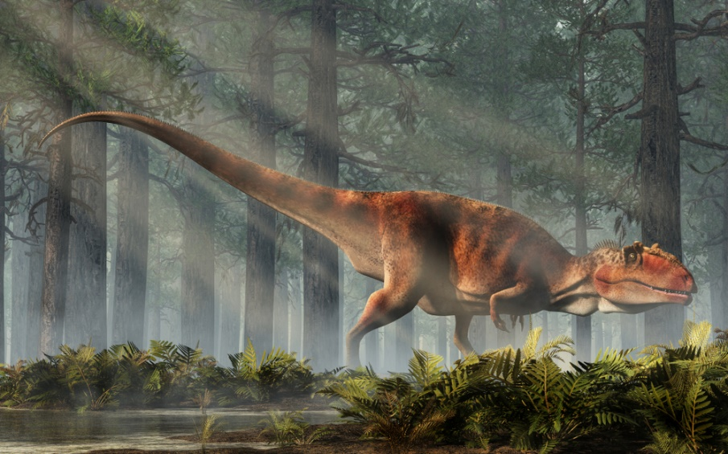
The southern half of Pangaea was known as Gondwana.
Gondwana was made up of South America, Africa, Antarctica, Australia, India and New Zealand. Like Laurasia, the climate in Gondwana was warm and humid.
As geological time progressed, Gondwana developed its own, slightly less famous lifeforms that were not found on Laurasia—and perhaps luckily, aren't still around today! One such animal was a dinosaur called Giganotosaurus, whose head alone was as big as an adult human. It's thought this dinosaur was so large that it could have swallowed a human in a single bite!
Gondwana was also home to distinctive groups of mammals and flowering plants.

Slide 24
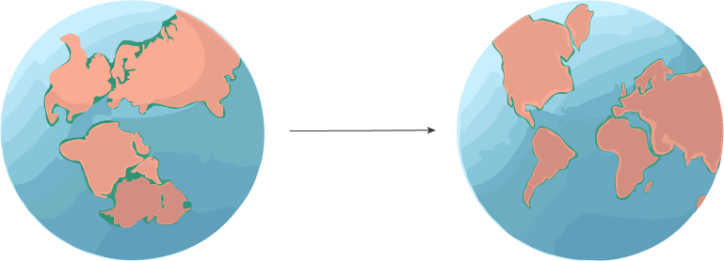
Tectonic plates are always moving, so over time, these supercontinents began to change.
Laurasia slowly broke up to form North America, Europe and Asia between 66 and 30 million years ago. Gondwana split much earlier to form the rest of the Earth's continents.
Some of these continents, such as Australia, have remained very stable in shape during these various splits. This suggests the continental crust they have been built from is very old and thick. If the crust is thick, then it is likely to survive more collisions and rifting in one piece as the tectonic plates move. However, the continents that we know today are still slowly moving, a little bit closer or further away from each other every year!

Slide 25
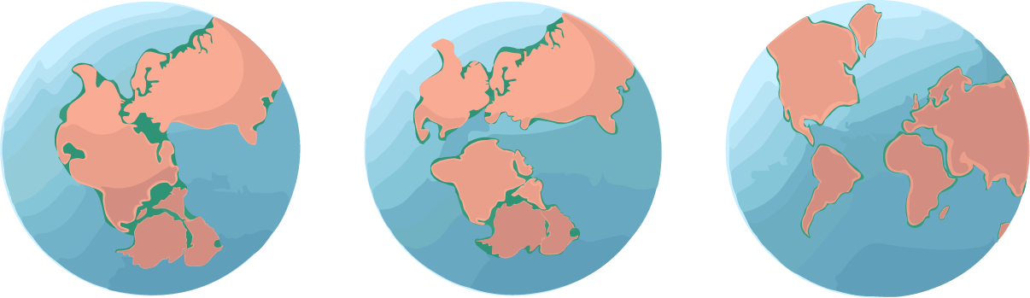
So, what have we learnt about supercontinents so far?
Well, over 300 million years ago, almost all of the world's landmasses were pushed together to form a giant supercontinent called Pangaea. Pangaea had extreme seasonal changes with very little rainfall and was host to the biggest mass extinction event. However, new life did manage to flourish there as well!
Around 200 million years ago, Pangaea slowly began to split into two smaller supercontinents: Laurasia and Gondwana. The climate on these landmasses was warmer, less extreme and humid—perfect for an explosion of life.
Eventually, Laurasia and Gondwana split into the continents we are familiar with today!

Slide 26
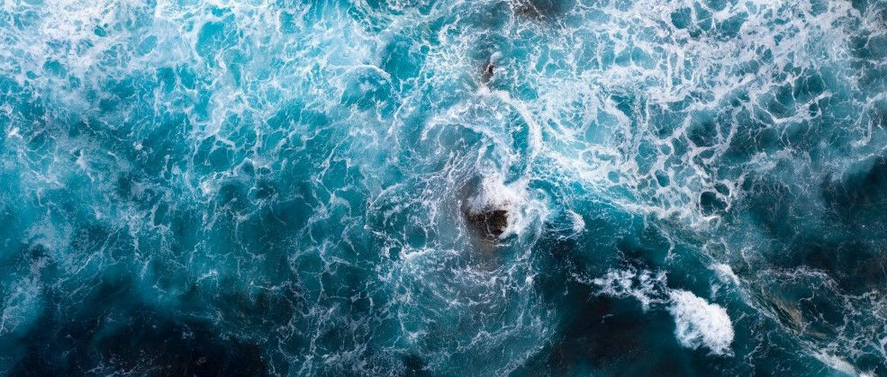
This journey only covers the last 300 million years, but remember that geologists estimate that the Earth is 4.5 billion years old!
What was happening on Earth during this time? Surely there was land and tectonic plate movement? Let's jump back in time to about 3 billion years ago to find out, where the world looks truly bizarre.
The world's oldest supercontinent was formed at this time, called Ur. Geologists think it was a small landmass, only slightly bigger than New Zealand.
It's called a supercontinent because it's thought to be the only continent that existed 3 billion years ago. There may have been some islands scattered about, but it appears the early Earth had very little dry ground.

Slide 27
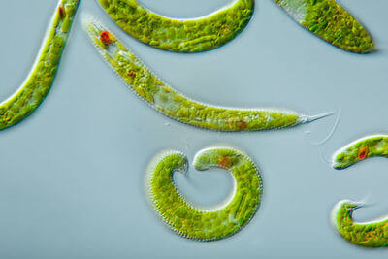
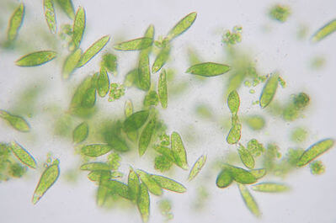
Zoom to 1 billion years ago and Ur changed considerably. Back then, Earth was dominated by a supercontinent called Columbia.
Columbia was a dry and barren land that was formed from Ur, but it was filled with tectonic activity. Volcanoes, subduction and erosion all resulted in the formation of mountains and new land.
The only life forms on Columbia were microscopic single-celled organisms. These life forms were important, as without them we and all of the other multi-celled organisms on Earth would not have been able to evolve!

Slide 28
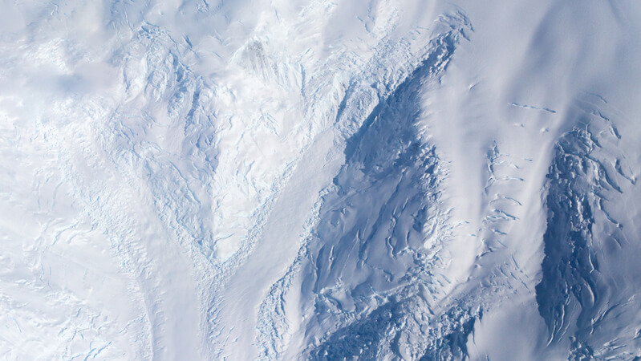
Finally, we arrive at Rodinia around 700 million years ago.
Once you see Rodinia, you'll see why we started this journey at Pangaea. Rodinia was a giant supercontinent that, like Pangaea, contained much of the world's land. However, all of this land was completely covered in ice!
The temperature rarely got to above −50°C, and almost the entire ocean, as well as Rodinia itself, was covered in glaciers several kilometres thick. To top it all off, there wasn't enough oxygen in the atmosphere to breathe.
These supercontinents weren't exactly teeming with life. For us, life as we know it really begun on Pangaea all those millions of years ago!

